Slide 1


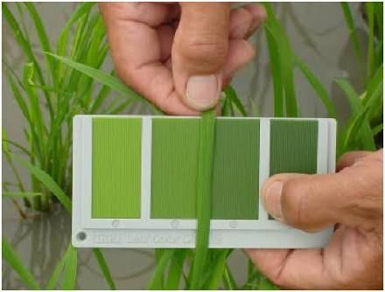
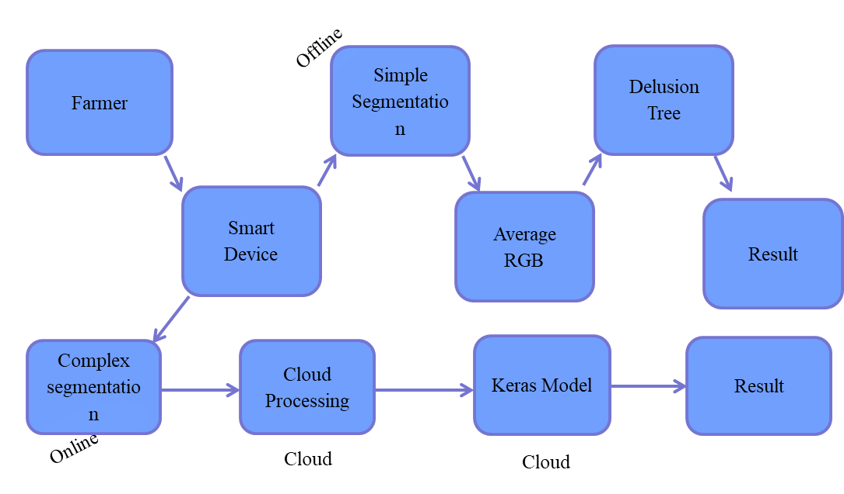
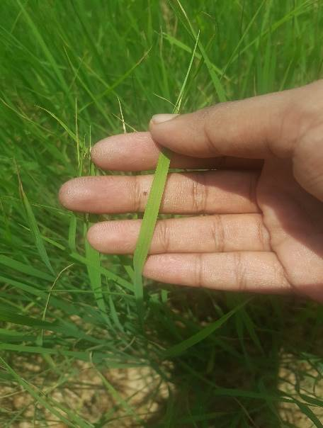
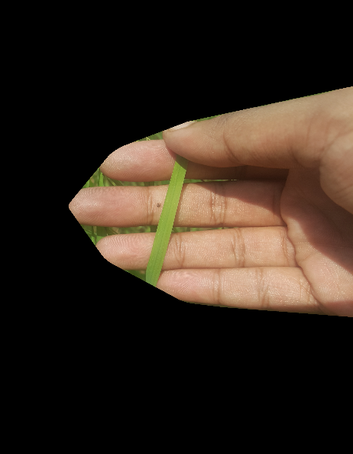


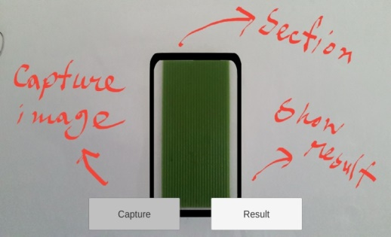

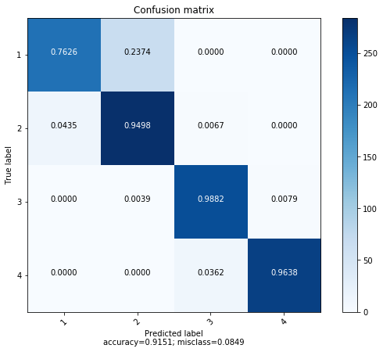
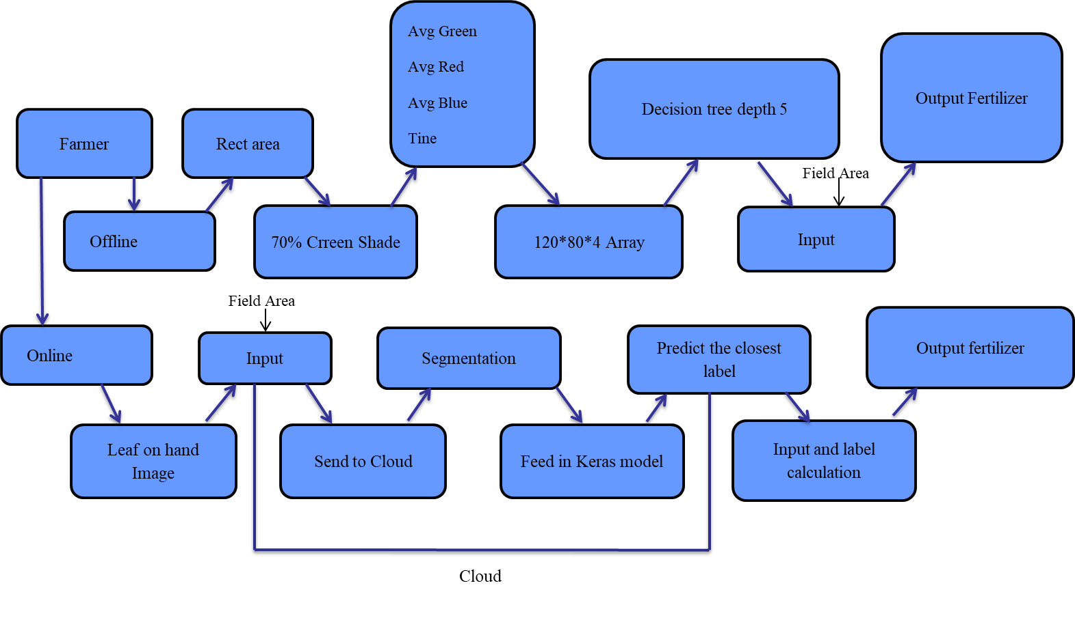
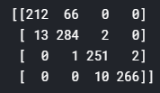

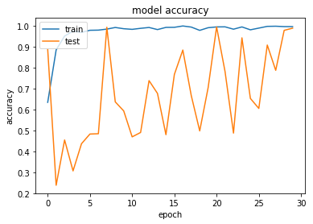

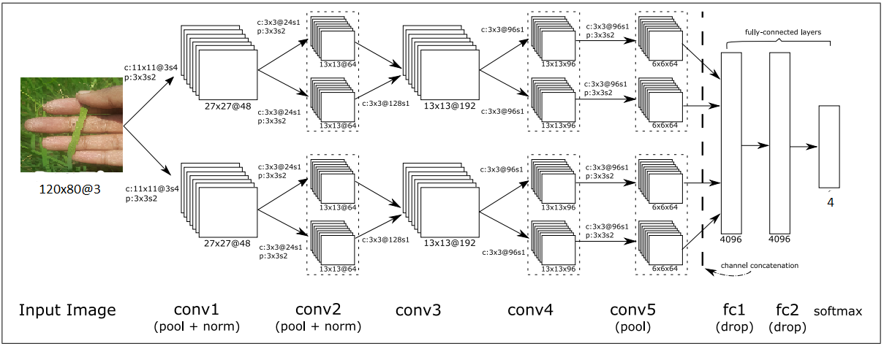
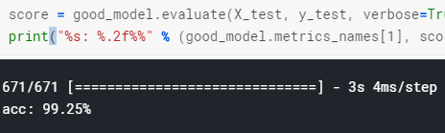




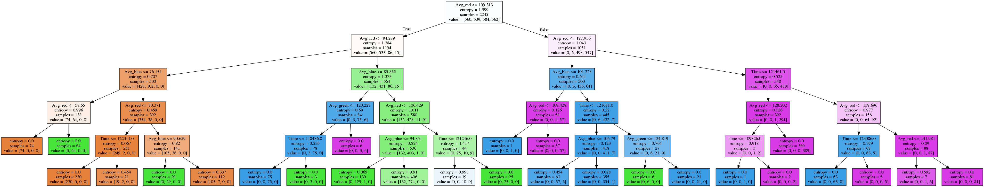
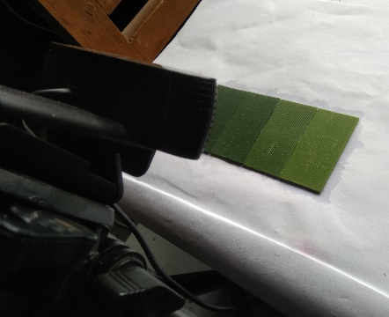
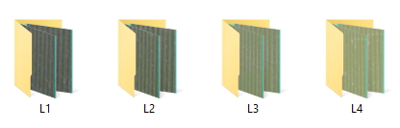
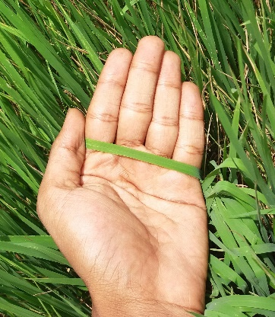
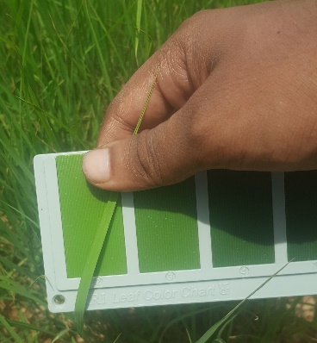
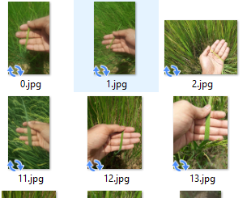
DIGITAL LCC (LEAF COLOR CHART)
Rafsan Uddin Beg Rizan (1402061), rafsan12@cse.pstu.ac.bd
For making digital Bangladesh, we need to make agriculture system digital. But farmer's uses manual system to give fertilizer. Automation the presses of LCC by capturing image from application.
Segmentation
First detect skin color, find contours. Draw a convex hull mask it. Than detect green shade from HSV range mask it.
Step 1
Step 2
Step 3
Data flow
Decision Tree:
Neural Network:
High computing PC
Different lighting condition
Adding Time dimension to RGB -> RGBT
No SPAD meter.
Ideal:
Image taken from 9:00 am to 1:30 pm
Normal:
Conclusion:
What has been done:
Standard LCC benchmark
The captured image of LCC’s photo printing in an ideal lighting condition and normal condition
Offline implementation and online backend developed.
Auto segmentation without white paper
Ideal data collection with different lighting condition and time.
Normal data collection with respect to LCC and time
Comparing result with other methods.
Application:
Waste free fertilization.
Automatic fertilization.
Error free fertilization.
Fertilization for other plants also.
Faculty of Computer Science and Engineering (CSE), PSTU
Dumki, Patuakhali – 8602.

